Slide 1
Model Building for future temperature increases in Australian Regions
Dillon Dugan

Slide 2
Purpose and Research Question
As with most of the world, climate change has introduced many challenges on the ecosystems of the planet with increased temperature, drought, heatwaves, air pollution, etc.
One of the most devasting events of the past year was the severity of the Wild bushfire of 2019-2020 in Australia. Increased drought and temperature, due to climate change, aided in creating one of the worst wildfires in Australia in modern history.
The lack of preparation as well as the severity of the fire lead to not only the death of 479 humans, but nearly 2.8 billion wildlife were affected, 3 times the predicted amount that was going to be affected. The fire burned for 46 million acres over June 2019 to May 2020
Creating accurate predictors of increased temperature and drought conditions can help emergency services and wildlife protectors be better equip to fight future wildfires
What regressor algorithm(s) would have the best predictive power for Australian climate data?

Slide 3
Australian Climate Dataset
This dataset contains 113 rows of the average temperature and rainfall of each region in Australia and an average for all of Australia, Southern Oscillation Index, CO2 concentrations from Mauna Loa, and annual sunspot count over 1900 to 2012. This is a total of 22 columns
The regions are Eastern, Southeastern, South, Southwestern, Western, Northern, Murray-Darling basin.
Southern Oscillation Index is the barometric pressure difference between French Polynesia and Darwin, Northern Territory, Australia
The dataset is composed of data from the Australian Bureau of Meteorology to provide temperature, rainfall, and SOI data, CO2 series data from Global Monitoring Laboratory in Mauna Loa, Hawaii, and sunspot data from Solar Influences Data analysis Center

Slide 4
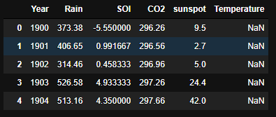
Input and Output variables
To avoid too many features causing overfitting, the average rainfall for all of Australia, SOI, Year, CO2 concentration, and sunspot count will be used as input variables to predict the average temperature for all of Australia.
Therefore the temperatures and rainfall for all the regions will be removed. This could be a potential future project use the algorithm with all the regions and have accurate temperature prediction over multiple areas to assess the most at-risk regions
This will put the working dataset as having 6 columns instead of the given 22 from the original data source

Slide 5
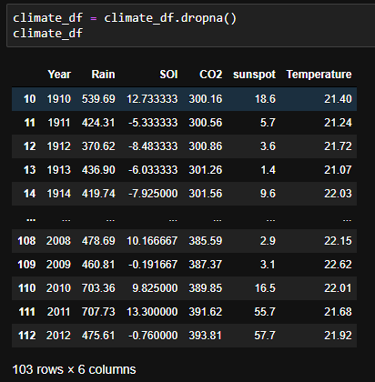
Data Preprocessing and Cleaning
Removing the unnecessary columns, the data set becomes 113 rows with 6 columns, 5 features and 1 outcome. However, there is missing values for temperature from 1900-1909 that needs to be removed using dropna(). This puts the working dataset at 103 rows with 6 columns. There was also some cleaning of the column names as auRain and auAVt isn’t as clear as Rain and Temperature
Otherwise, the data was pretty clean with not a lot of noise

Slide 6
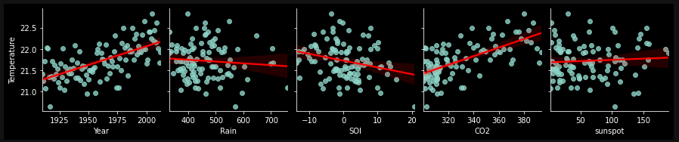
Pair plots of Each Feature to Temperature
Seemingly there is some correlation between Year, SOI, and CO2 with Temperature. It makes sense with climate change, that as time and CO2 concentration increase, the temperature increases. The SOI almost seems unintuitive as pressure increases as temperature increases and vice versa. However, it is a difference between French Polynesia and Darwin barometric pressure thus a decreasing SOI implies increasing Darwin barometric pressure or decreasing French Polynesia barometric pressure

Slide 7
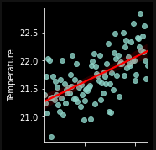
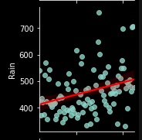
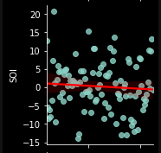
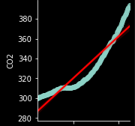
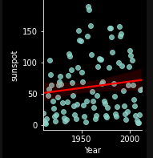
Pair plot
Here are some pair plots of the features and temperature over the past century

Slide 8
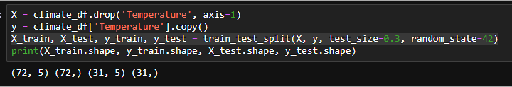
Data splitting
Data will be split using train_test_split using testing size of 0.3. This gives a training size of 72 rows and test size of 31 rows

Slide 9
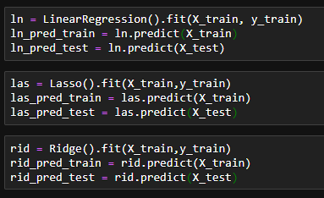
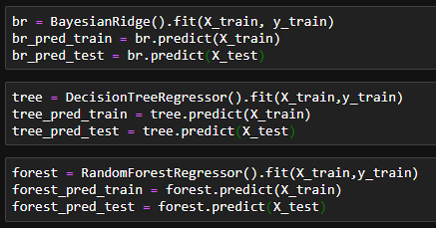
Regression Algorithms used
Linear Regression, Lasso Regression, Ridge Regression, Bayes Ridge Regression, Decision Tree Regression, and Random Forest Regression were used for modeling building with the Australia climate data. Creating predictions can create comparison for the models using mean_squared_error()

Slide 10
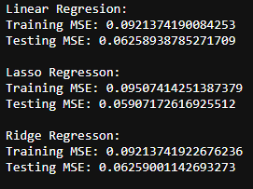
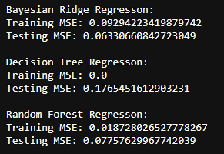
Model Evaluation
Clearly, all the models performed really well with no overfitting as the MSE values are very low and about equal between training and testing sets.
However, Random Forest Regressor seems to have the best predictive analysis of average temperature, having the lowest MSE values for training and testing

Slide 11
Conclusion
The best algorithm for the research task was Random Forest Regressor, with some hyper tuning and increased data pool sizes, this model could yield a higher predictive power. This means that by using Random Forests, future temperatures can be predicted off of trends of rainfall, CO2 concentrations, SOI changes, and count of sunspots
Using this algorithm can be switch from average of Australia to averages of regions of Australia to assess the regions at risk of extremely dangerous wildfires such as the 2019-2020 bush fire that claimed so many wildlife.

